Slide 1
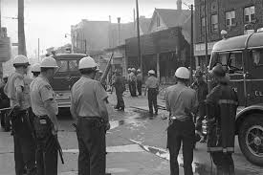
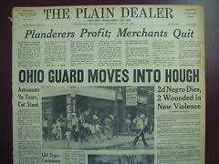
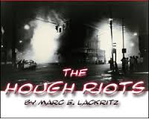
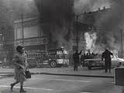
HOUGH RIOTS
LAQUESHA JONES
ELA 5TH/6TH
MAY 8, 2015

Slide 2
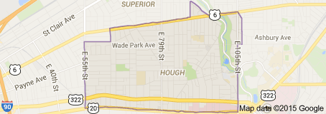
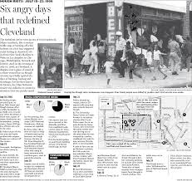
HOUGH The Neighborhood

Slide 3
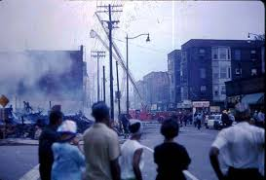
HOUGH RIOTS *Where & When*
The Hough Riots were race riots that took place in the predominately African-American area of Hough (huff) in Cleveland.
It took place over a 6-night period from July 18, through July 23, 1966.

Slide 4
Hough Riots History
It was high old times in Hough during its heyday from 1880 to 1920. Hough was a place to see and be seen. Society’s elite carved out a unique existence along Euclid Avenue making this Cleveland-Hough corridor the showpiece of the Midwest. Replete with topiary gardens and Grecian fountains, the name Hough came to symbolize prosperity.

Slide 5
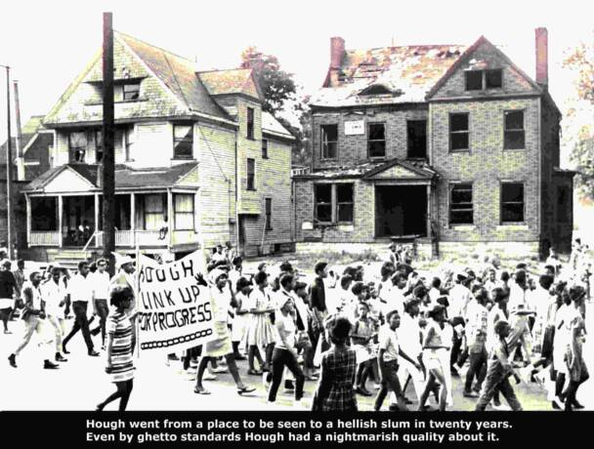
Hough Riots History
By the 1950s things would change drastically. Economic and social transformations began to chip away at Hough’s wealth and luster. By the 1960s, with any vestige of prominence long gone, Hough had become an overcrowded, rat infested ghetto destined to have its star rise one last time as a dubious chapter in the riotous ‘60s.

Slide 6
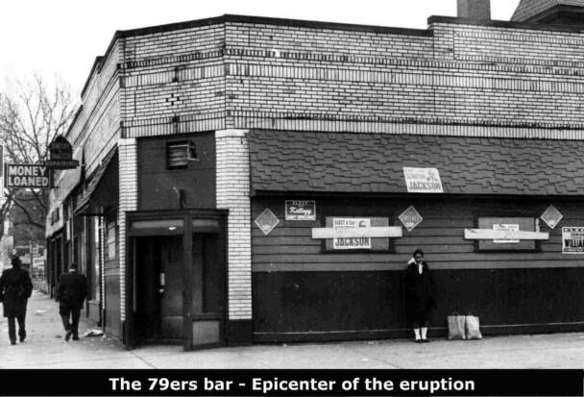
Hough Riots CAUSE!
The riots were sparked by a dispute over a glass of water at the Seventy-Niners Cafe at Hough Ave. and E. 79th St. on the evening of 18 July, which escalated until the police were unable to deal with the situation. As the crowd grew larger, rock throwing, looting, and vandalism gradually spread throughout the Hough area. The following evening the violence was repeated, with fires set in the area as well as reports of sniper fire.

Slide 7
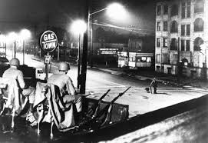
Hough Riots EFFECT!
At the request of Mayor Ralph Locher, the Natl. Guard moved into HOUGH on the morning of 20 July to restore order, and the mayor closed all bars and taverns. After a major fire at Cedar and E. 106th on the 21st, things slowly returned to normal. On Monday, 25 July, those stores in the Hough area that had escaped serious damage reopened, and the Natl. Guard was gradually released from duty. During the riots, 4 people were killed, about 30 were injured, close to 300 were arrested, and approx. 240 fires were reported. There was no evidence that the riots had been planned or controlled by radical groups in Cleveland.

Slide 8
HOUGH RIOTS PICTORIAL

Slide 9
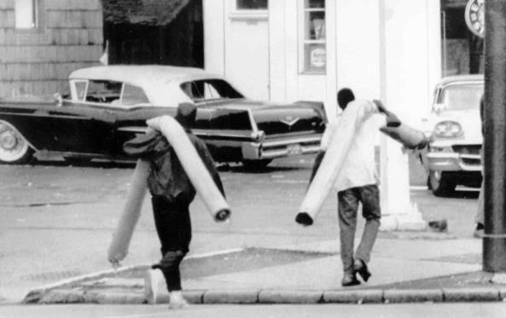
HOUGH RIOTS PICTORIAL

Slide 10
HOUGH RIOTS PICTORIAL

Slide 11
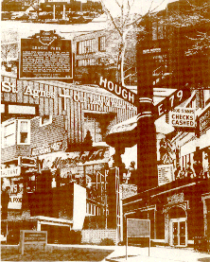
Hough Now!
Despite the persistence of poverty and widespread deterioration, the people of Hough together with city officials and private developers have forged partnerships to rebuild the neighborhood and restore its pride. The 1980s and 1990s witnessed signs of rebirth in Hough – the Lexington Village townhouse complex, construction of numerous stately single-family homes and the new Church Square shopping center at East 79th and Euclid.

Slide 12
Hough Riots
Hough Riots A Video

Slide 13
Hough Riots Citations
"Encyclopedia of Cleveland History: HOUGHRIOTS." Encyclopedia of Cleveland History: HOUGH RIOTS. N.p., n.d. Web. 30 Mar. 2015.
"Hough." The Neighborhood Home Page. N.p., n.d. Web. 30 Mar. 2015.
"Hough Riots Photograph." Clio. N.p., n.d. Web. 30 Mar. 2015.
Rivers, Larry. "Hough Riots: "Was It Good?"" YouTube. Digital Humanities, n.d. Web.

